Slide 1
Salesforce Testing Kiran kumar puli

Slide 2
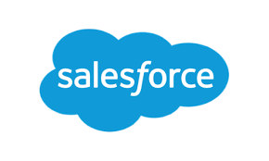
AGENDA
Salesforce intro & cloud services
Levels of Salesforce testing
Objects in Salesforce
Roles & Profiles

Slide 3

SALesforce
Salesforce is a cloud based Customer relationship management (CRM) platform that helps businesses of all the sizes to manage their sales, marketing, customer services and other related activities.
The company was founded in 1999 and headquartered in San Francisco, California.

Slide 4
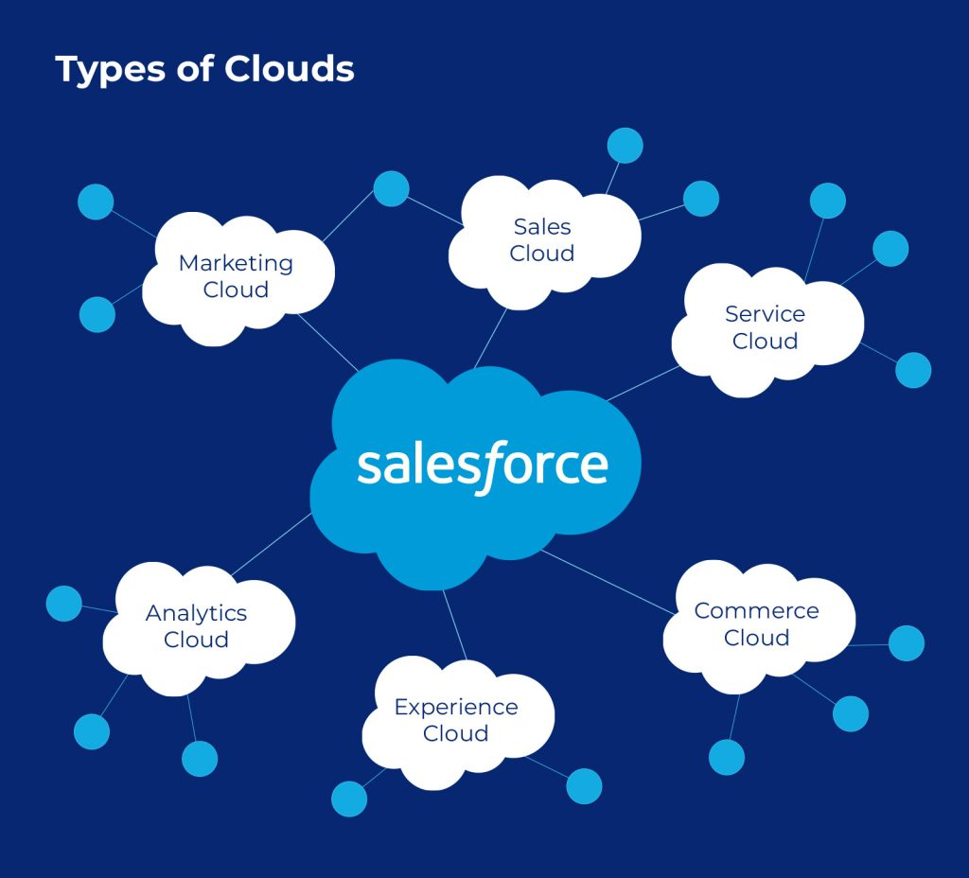
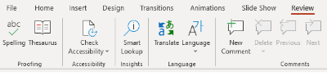
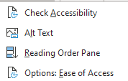
CLOUD service's in Salesforce
Sales Cloud: Lead Management, Account & Contact Management, Opportunity management, sales collaboration.
Service cloud: Customer Service & Support Application.
Commerce cloud: Order management, Merchandising,
AI-powered personalization.
Experience Cloud: Content Management, Personalization.
Analytics Cloud: Data integration, Data Visualization, Mobile access.
Marketing cloud: Email Marketing, Social Media, data management, Analytics.
Accessibility: Best practices
Use the Accessibility checker
Make sure that content is well structured and clearly written (use headings and lists appropriately).
Give every slide a unique title
Make sure slide contents can be read in the order that you intend
Ensure that color is not the only means of conveying information
Ensure sufficient contrast between text and background colors
Describe the illustrations that convey information (e.g.: include alternative text). Otherwise, mark them as “decorative”.
Use a simple table structure for data only and specify column header information.
To finalize
To lower the total weight of the presentation, delete the unwanted page/image and/or master slides
It is recommended to reduce the size and send a PDF copy to your stakeholder/s: ‘Save as Adobe PDF.

Slide 5
Levels of Salesforce Testing
Unit Testing : Unit tests help to ensure a piece of code is functioning as expected.
QA Testing : QA testing is performed to ensure that the system is working as defined by the business requirements.
UAT Testing : UAT(User Acceptance Testing) is performed by actual users of a system.
Production Testing: Performed upon successful deployment to the production environment,
usually Smoke testing is used.
Regression Testing: Ensures existing functionality is not broken after a new deployment

Slide 6

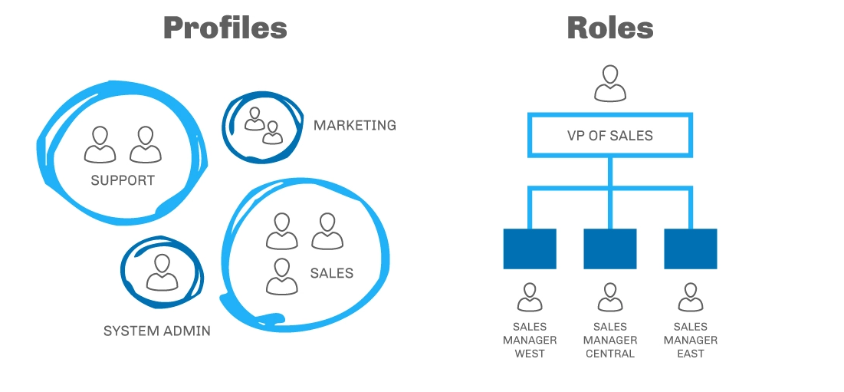
Roles & Profiles
Roles is a record-level access in Salesforce that defines the visibility access of a user. Roles can be used to specify the levels of access a user can have to data in your Salesforce organization.
Profiles are Set of Permissions and settings that define what users can see and do with in Salesforce platform.
Profiles can also control what users can with in the platform, such as which fields and objects are Visible

Slide 7
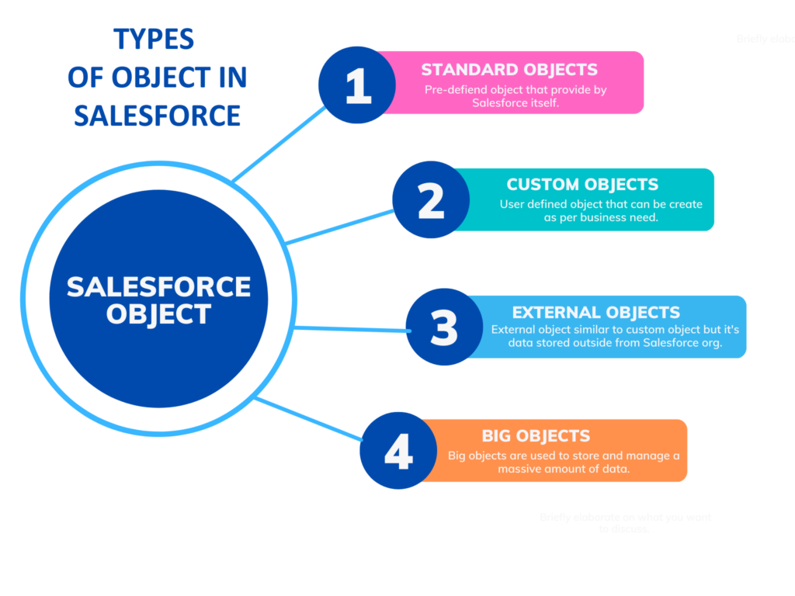

Slide 8
Learning Paths:
Kicker box

Slide 9
Title (Work for 1 or 2 lines of title)
Header
Header
Header
First level
Second level
Third level
Fourth level
Fifth level
First level
Second level
Third level
Fourth level
Fifth level
First level
Second level
Third level
Fourth level
Fifth level

Slide 10

Thank you
capgemini.com

Slide 11
About Capgemini
Capgemini is a global leader in partnering with companies to transform and manage their business by harnessing the power of technology. The Group is guided everyday by its purpose of unleashing human energy through technology for an inclusive and sustainable future. It is a responsible and diverse organization of over 360,000 team members more than 50 countries. With its strong 55-year heritage and deep industry expertise, Capgemini is trusted by its clients to address the entire breadth of their business needs, from strategy and design to operations, fueled by the fast evolving and innovative world of cloud, data, AI, connectivity, software, digital engineering and platforms. The Group reported in 2022 global revenues of €22 billion.
Get The Future You Want | www.capgemini.com

